Slide 1
Layoff Management System

Slide 2
Team
“In Teamwork, there is strength”
01
Ronak Bhavesh Chheda
02
Kartheek Dabbiru
03
Sahil Gadge
04
Keerthana Sagar Sathish Babu
05
Anwesh Kumar Singh

Slide 3
Problem Statement/ Objective
01
Lack of situational dependencies
LinkedIn and Indeed do not consider situational dependencies such as visa constraints, time to find a job
02
Absence of a centralized database
No comprehensive and centralized database system leading to data redundancy and difficulty in tracking
03
Multiple jobs offered to one person
Person may get offered multiple jobs, results in inconvenience and confusion for both the individual and the company.

Slide 4
Approach and Design Considerations
Entity Relationship Diagram on next page
Divide and Conquer
Detail Tracking
Users provide accurate and truthful information

Slide 5
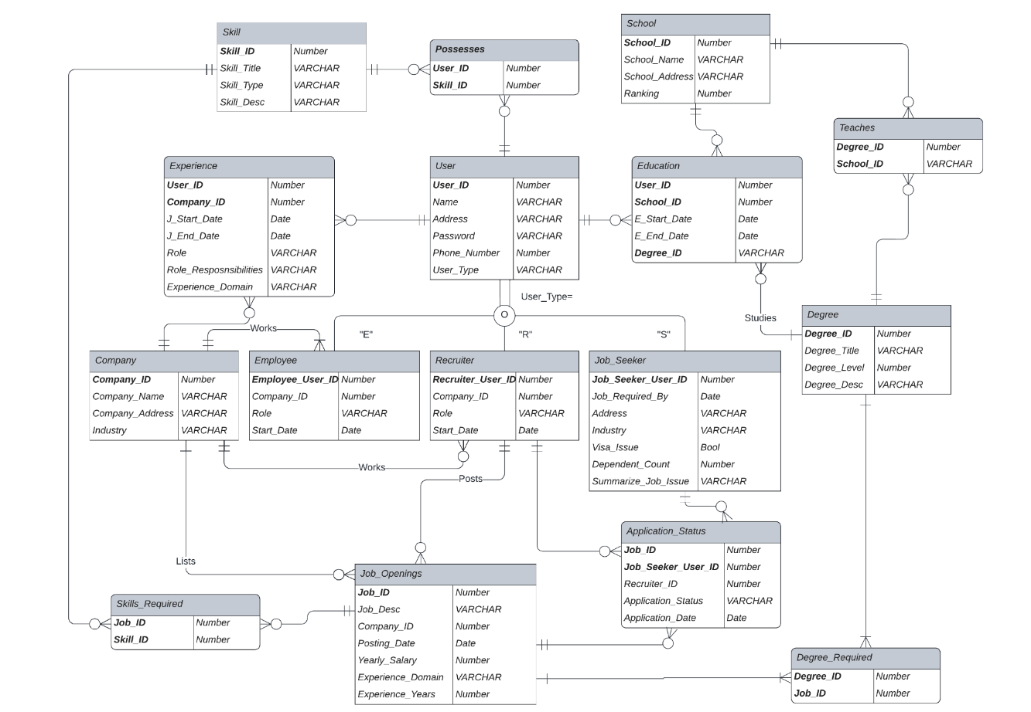

Slide 6
Database Objects
01
Triggers
02
St Procedures
03
Views
04
Encryption
[Insert] To calculate Age of user
[Update] To ensure 1 job is offered per user
Get job openings by Company Name
Move hired job seeker under employee role
Returns employee count of any company
Lists job posted in last 24 hours
Lists job seekers with visa issues
Lists user who have more than 2 years of experience
User password is encrypted with AES

Slide 7

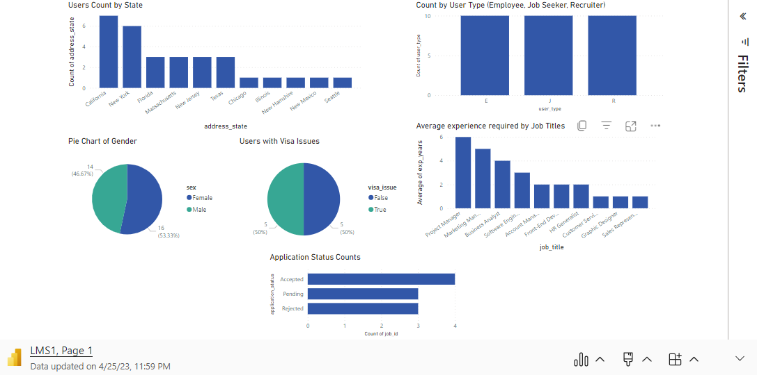
Microsoft Power BI

Slide 8
Demo

Slide 9

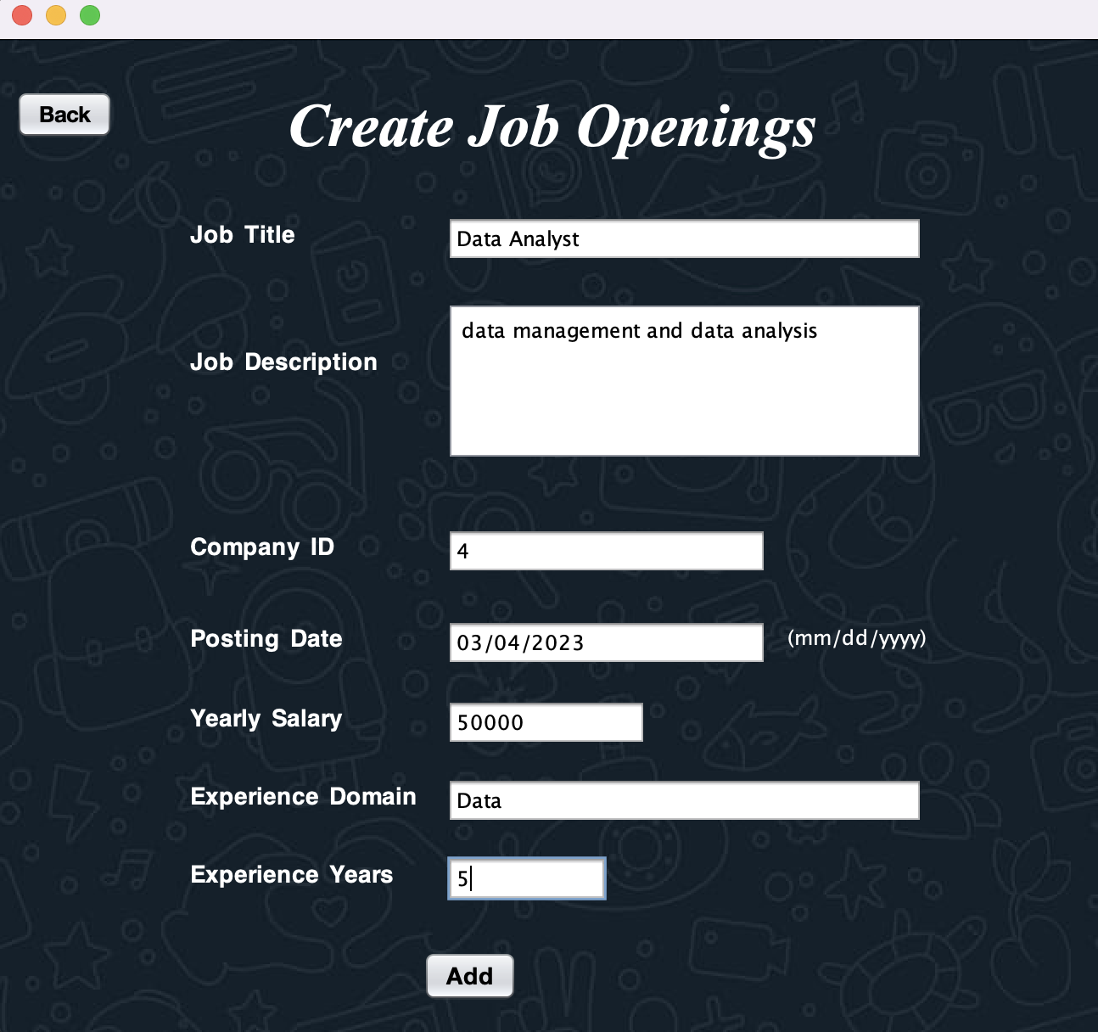
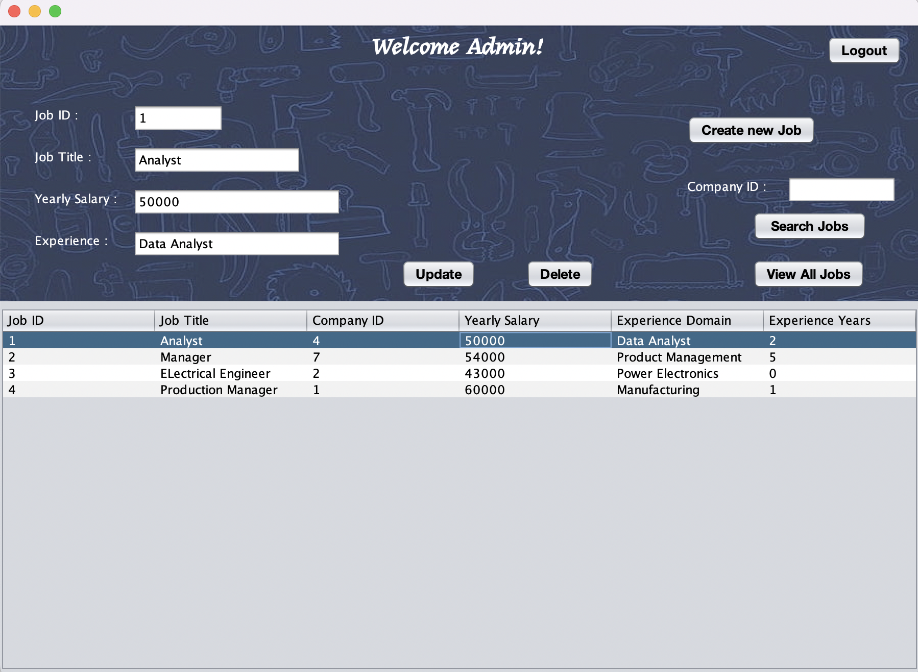
Graphical User Interface

Slide 10
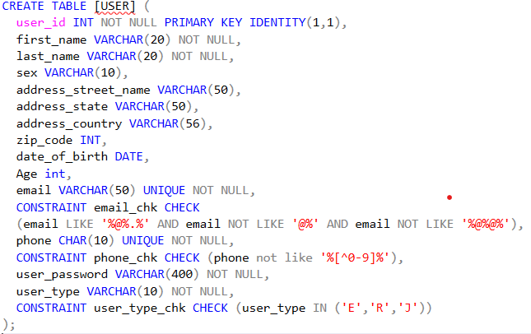
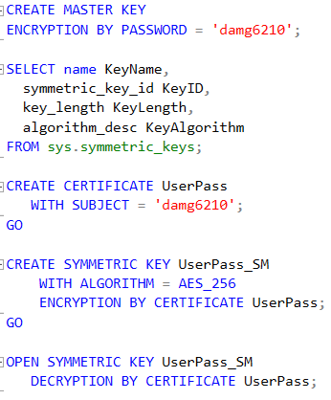
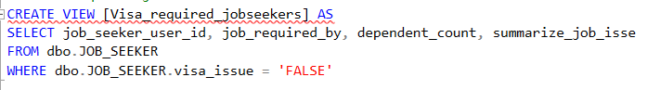
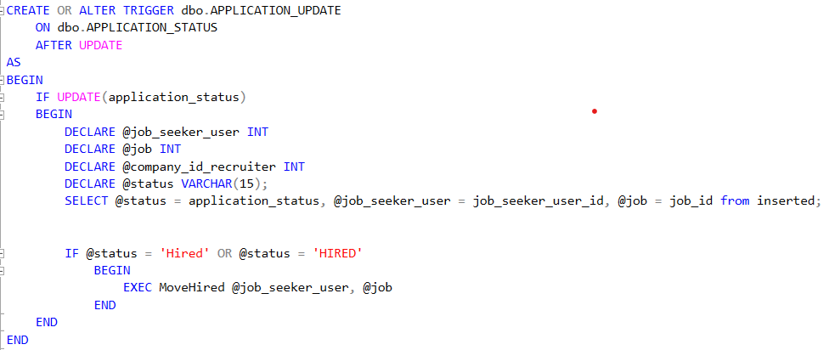
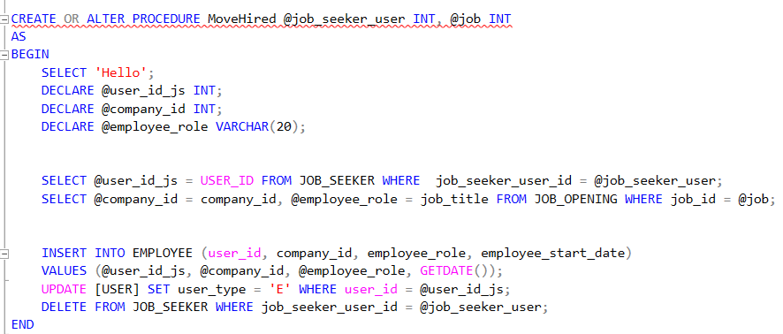
Database Objects
ENCRYPTION
DDL
VIEWS
TRIGGERS
STORE PROCEDURE

Slide 11
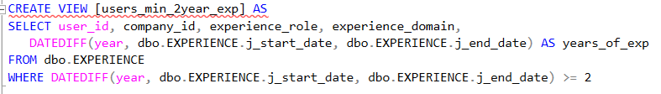
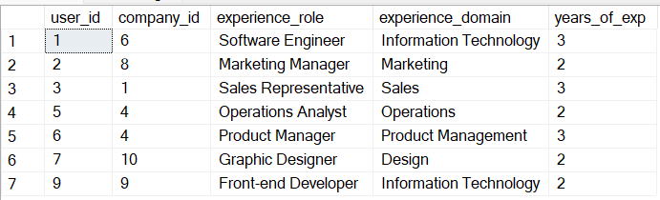
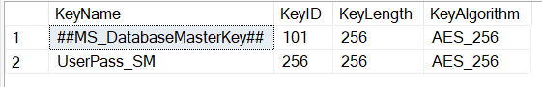
DEMO
DEMO 1
DEMO 2

Slide 12
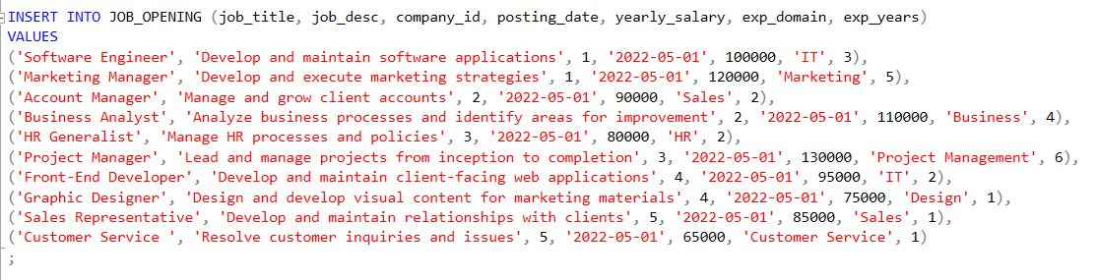
DATA POPULATION

